Slide 1
Theories of Neural Networks – part 2
Prof. Yong Won SEO, Ph.D.
College of Business and Economics
Chung-Ang University

Slide 2


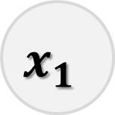
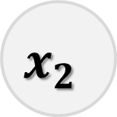
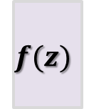
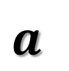


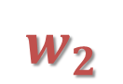
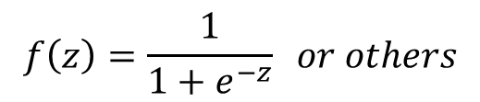
Single layer neural network example
input layer
output layer
$$x_{1}$$
$$w_{1}$$
$$x_{2}$$
$$w_{2}$$
$$Σ$$
$$z$$
$$f(z)$$
$$a$$
$$b$$
$$f\left(z\right)=\frac{1}{1+e^{−z}} or others$$

Slide 3
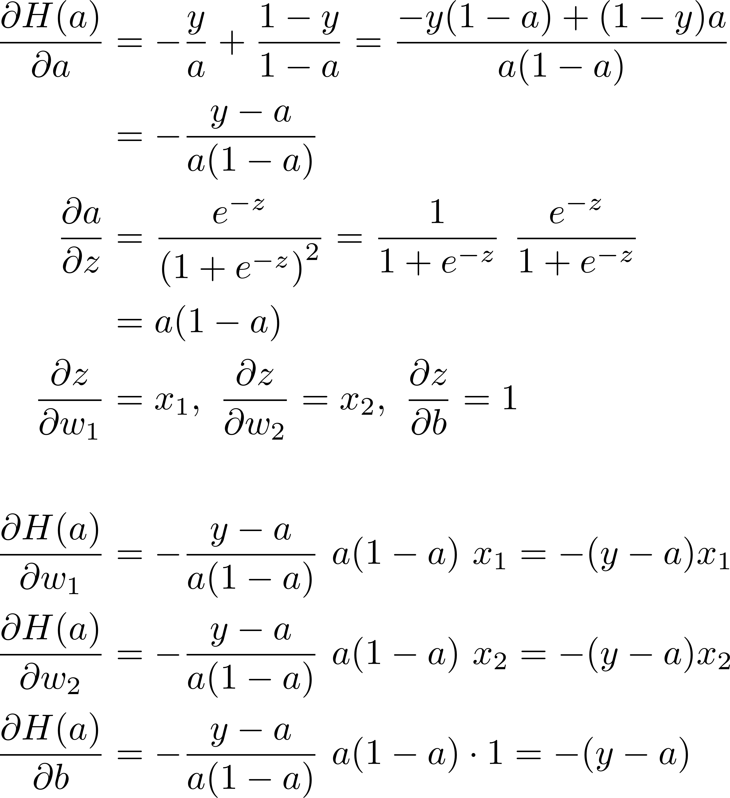
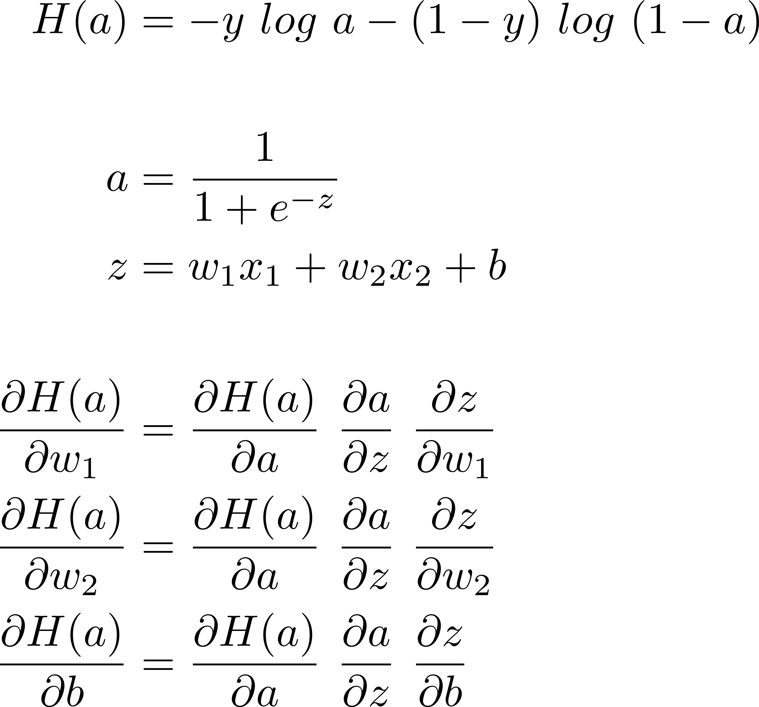
Learning : gradient

Slide 4
Binary classification
x1 | x2 | y
0 | 0 | 0
0 | 1 | 1
1 | 0 | 1
1 | 1 | 1

Slide 5
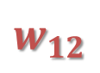
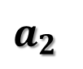
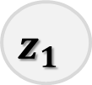
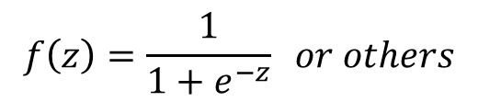
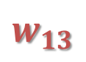


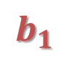
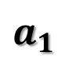
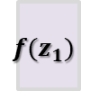
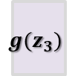
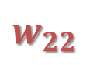
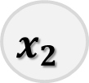
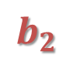
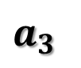
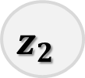
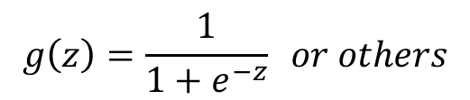
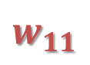
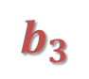
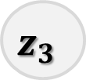

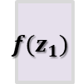
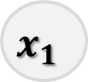
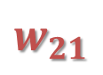
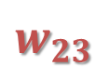
Binary classification : two layer case
input layer
hidden layer
output layer
$$g\left(z\right)=\frac{1}{1+e^{−z}} or others$$
$$b_{1}$$
$$x_{1}$$
$$w_{11}$$
$$Σ$$
$$z_{1}$$
$${f(z}_{1})$$
$$a_{1}$$
$$w_{13}$$
$$w_{12}$$
$$Σ$$
$$z_{3}$$
$${g(z}_{3})$$
$$a_{3}$$
$$w_{21}$$
$$w_{23}$$
$$Σ$$
$$z_{2}$$
$${f(z}_{1})$$
$$a_{2}$$
$$w_{22}$$
$$b_{3}$$
$$x_{2}$$
$$b_{2}$$
$$f\left(z\right)=\frac{1}{1+e^{−z}} or others$$

Slide 6
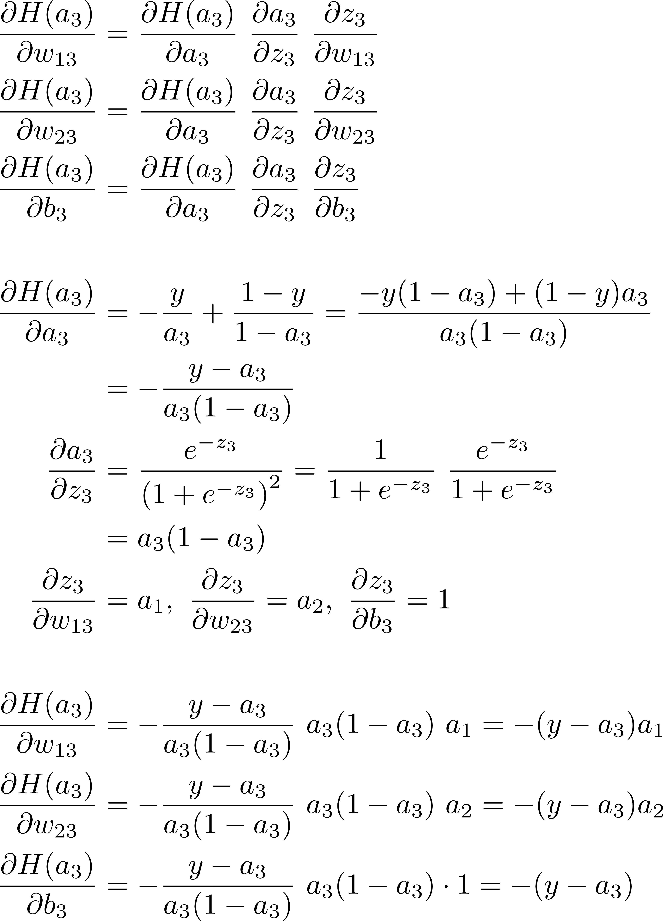
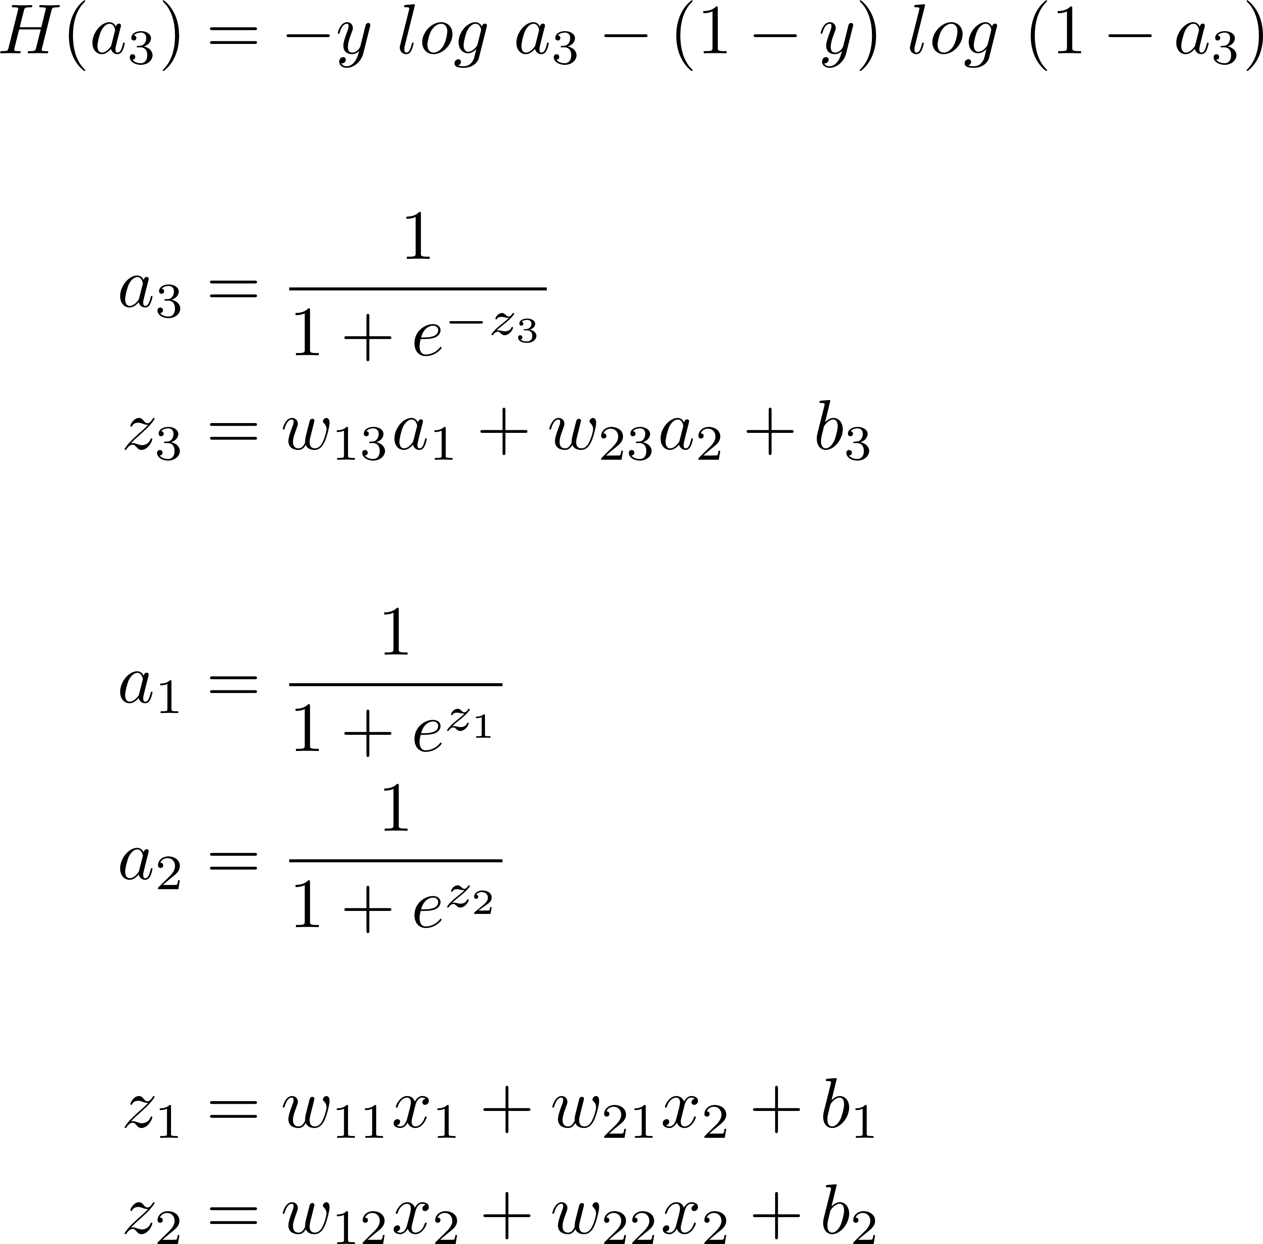
Backpropagation algorithm

Slide 7
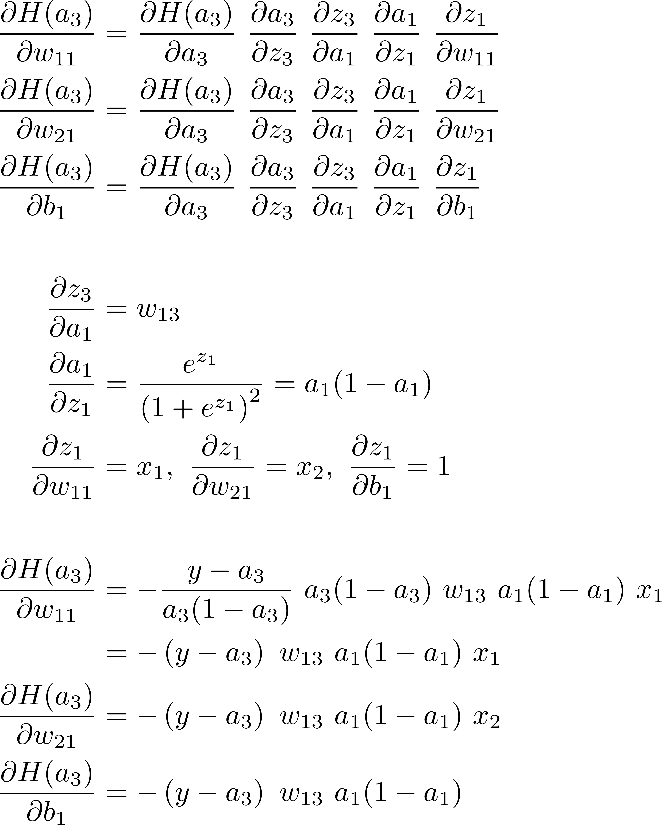
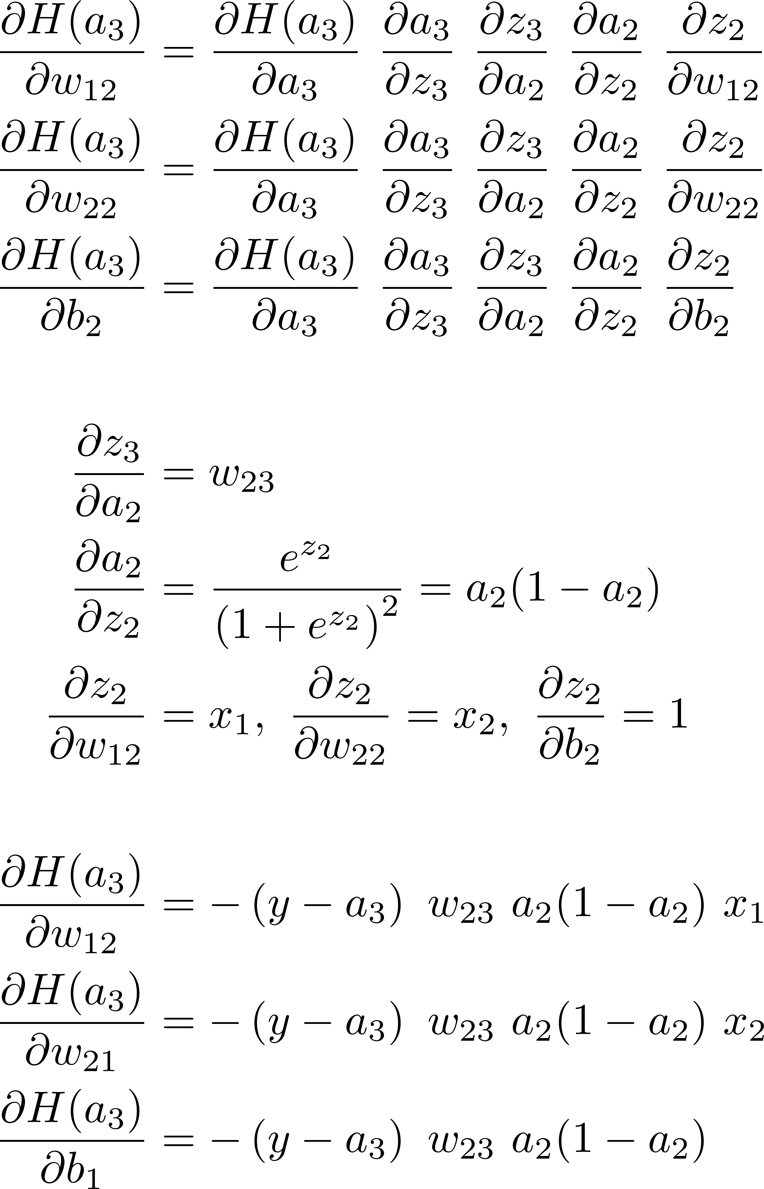
Backpropagation algorithm

Slide 8
Multiclass classification

Slide 9
Multiclass classification

Slide 10
Which case fits better?
better to make sum to 1
* Picture source: 박해선(2019), 이지스퍼블리싱

Slide 11
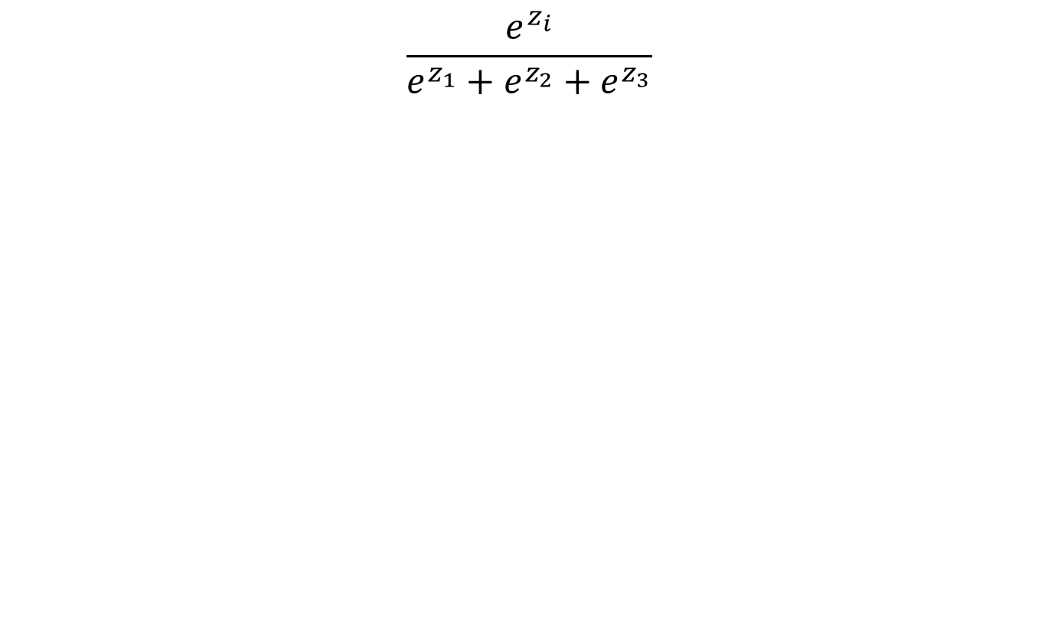
Softmax activation function
$$\frac{e^{z_{i}}}{e^{z_{1}}+e^{z_{2}}+e^{z_{3}}}$$

Slide 12
Softmax activation function
* Picture source: 박해선(2019), 이지스퍼블리싱

Slide 13
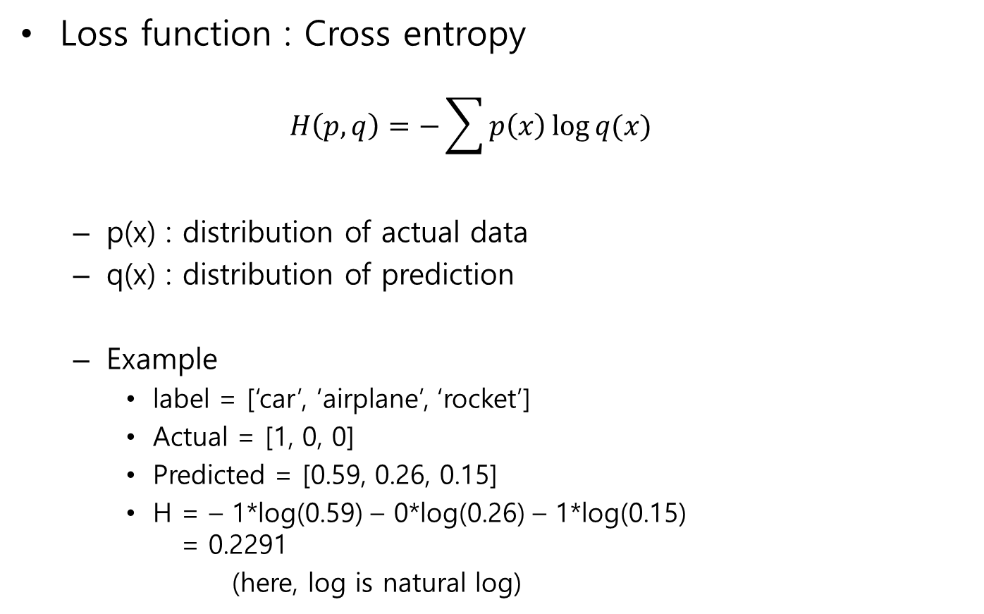
Cross-entropy loss function
Loss function : Cross entropy
$$H\left(p,q\right)=−\sum{p\left(x\right)\log{q(x)}}$$
p(x) : distribution of actual data
q(x) : distribution of prediction
Example
label = [‘car’, ‘airplane’, ‘rocket’]
Actual = [1, 0, 0]
Predicted = [0.59, 0.26, 0.15]
H = – 1*log(0.59) – 0*log(0.26) – 1*log(0.15) = 0.2291
(here, log is natural log)

Slide 14
Some important keras loss functions
mean_squared_error
when y label is continuous value
binary_crossentropy
when y label is 0 or 1
categorical_crossentropy
used when y label is encoded as [1,0,0], [0,1,0], [0,0,1] type
one-hot encoding
sparse_categorical_crossentropy
used when y label is encoded as integer (0, 1, 2, 3, …) type

Slide 15
Optimizer issues
Batch Gradient Descent (left) vs. Stochastic Gradient Descent(right)
Effect of learning rate
high learning rate
low learning rate
* Picture source: 허민석(2019), 위키북스

Slide 16
Optimizer issues
* Picture source: 허민석(2019), 위키북스

Slide 17
Optimizers
https://keras.io/optimizers/
http://shuuki4.github.io/deep%20learning/2016/05/20/Gradient-Descent-Algorithm-Overview.html
SGD (Stochastic Gradient Descent)
Adagrad (Adaptive Subgradient Method)
parameter-specific learning rates, which are adapted relative to how frequently a parameter gets updated during training
RMSProp : improves learning rate adjustment mechanism by exponential smoothing. frequently used for RNN’s optimizer
Adadelta : more robust extension of Adagrad that adapts learning rates based on a moving window of gradient updates, instead of accumulating all past gradients
Adam (ADAptive Moment estimation)
integrates adaptive learning rates and momentum optimizer
most popular

Slide 18


Slide 19


Slide 20


Slide 21


Slide 22
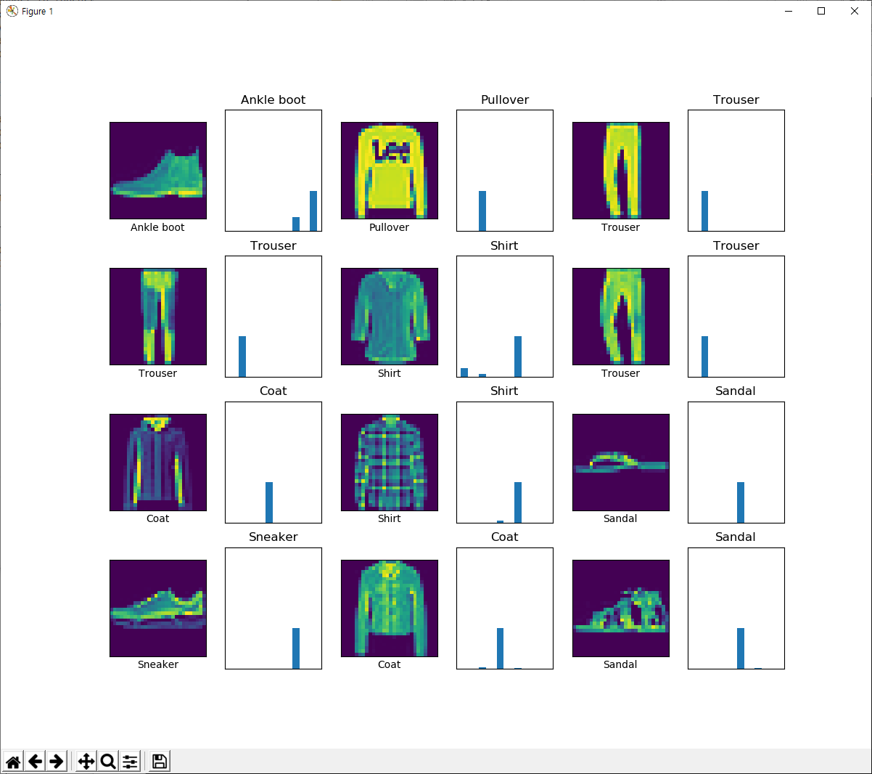

Slide 23
